Slide 1
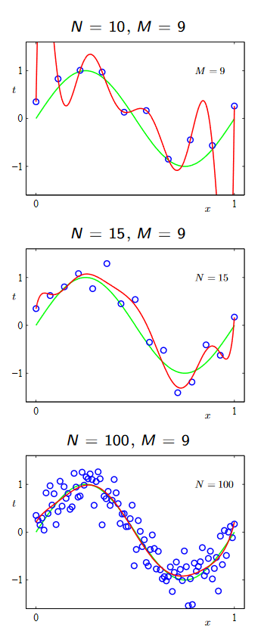



Classic Linear Regression
Regularization:
Classic methods
Lasso
Ridge
…
Bayesian priors
Zero-centered Gaussian

Slide 2



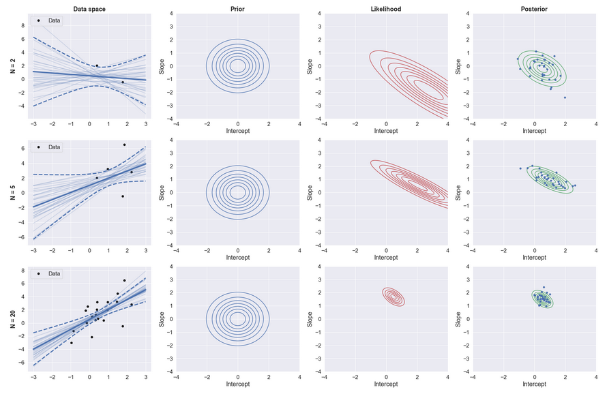
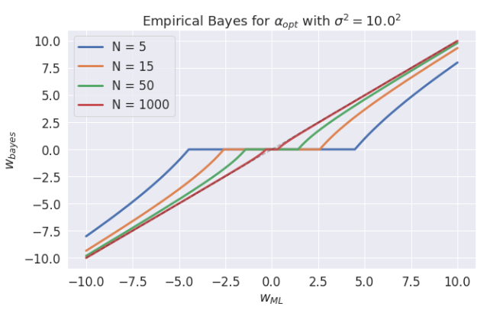
Bayesian Linear Regression

Slide 3



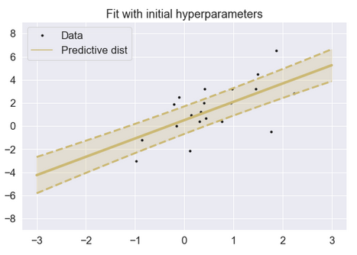
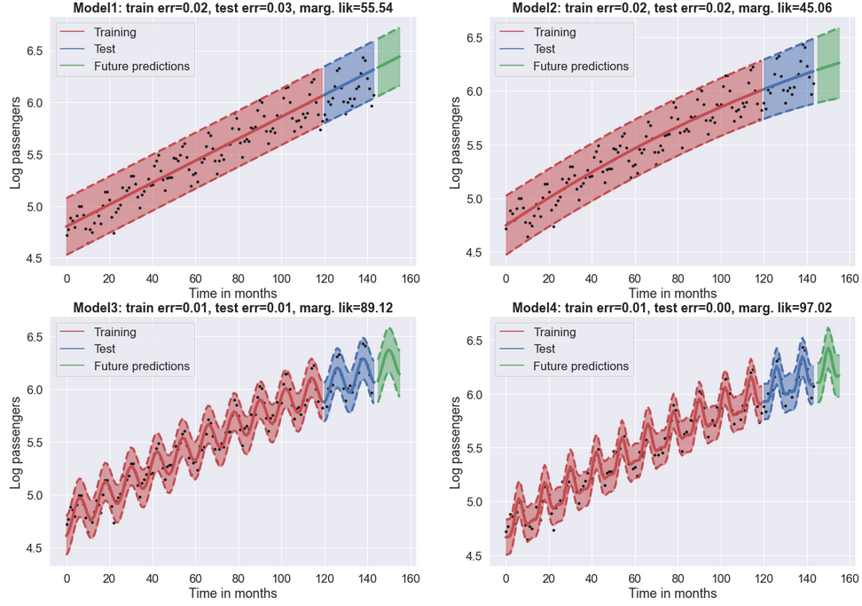
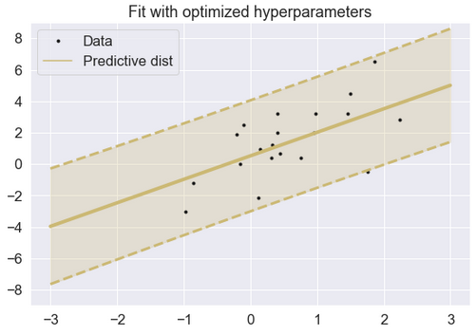
Empirical Bayes
Dirac-delta
Flat prior
Hyperparameter Fitting
Model Selection

